Slide 1
BERT-Based Sentiment Analysis for Low-Resourced Languages: A Case Study of Urdu Language
MUHAMMAD REHAN ASHRAF, YASMEEN JANA, QASIM UMER , M. ARFAN JAFFAR1 , SUNGWOOK CHUNG , AND WAHEED YOUSUF RAMAY
21241057 Malika Muradi

Slide 2
Introduction:
Implications in areas such as brand management, reputation monitoring, and market research
Sentiment analysis importance and its role in understanding public opinions
Related works:
Deep learning models such as CNNs, RNNs, LSTM, and GRUs
Transfer learning approaches like BERT and ELMo
Challenges:
Lack of annotated data for low-resourced languages
Need for language-specific preprocessing techniques
Methodology:
Urdu Dataset for Sentiment Analysis-23 (UDSA-23)
BERT-based approach for Urdu Text Sentiment Analysis (USA-BERT)

Slide 3
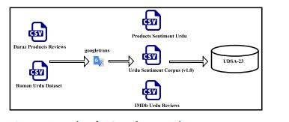
Dataset:

Slide 4
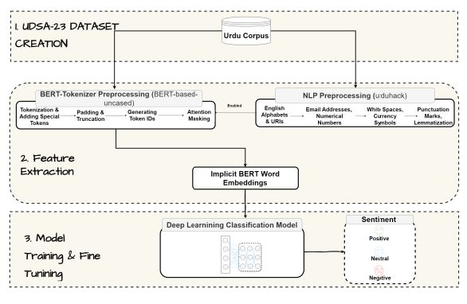
Preprocessing:

Slide 5
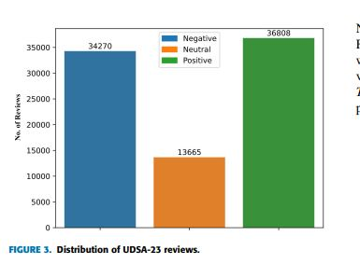
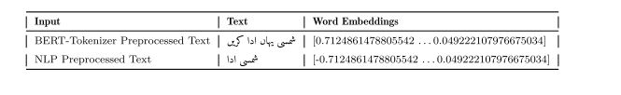

Slide 6
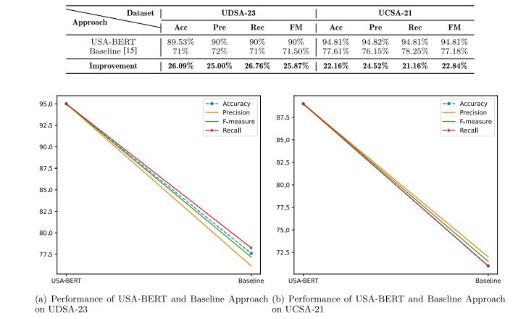
Result:

Slide 7
THANK YOU

